Slide 1
Applied Data Science Capstone Project
Optimal Japanese Restaurant Location In Manhattan
Jeremy Ross
4/18/2020

Slide 2
Introduction
This exercise will seek to show a good location to open up a Japanese restaurant in Manhattan.
This would be value to anyone looking to open up a Japanese restaurant based on certain criteria that is further discussed in the data section.

Slide 3
Data & Sources
Data
Sources
Number of any restaurant in each neighborhood
Number of Japanese restaurants in each neighborhood
Adjusted Gross Income (AGI)
Zipcodes
Latitude/Longitude (ie location of neighborhoods and restaurants)
Foursqure API
Source of file from 2014 NYU dataset that has coordinates of each New York City neighborhood
IRS data to get AGI by zip: https://www.irs.gov/statistics/soi-tax-stats-individual-income-tax-statistics-2017-zip-code-data-soi
geopy: this will enable mapping coordinates to zip code

Slide 4
Methodology
As mentioned earlier, we need to capture the following
Frequency of types of restaurants in each neighborhood
Number of any restaurant in each neighborhood
Number of Japenese restuarants in each neighbord
Adjusted Gross Income (AGI).
Although we do can do this at various income levels, we are looking only at areas where the AGI is 75k+
In addition, we will assess frequency of restaurants/top restaurants in each neighborhood

Slide 5
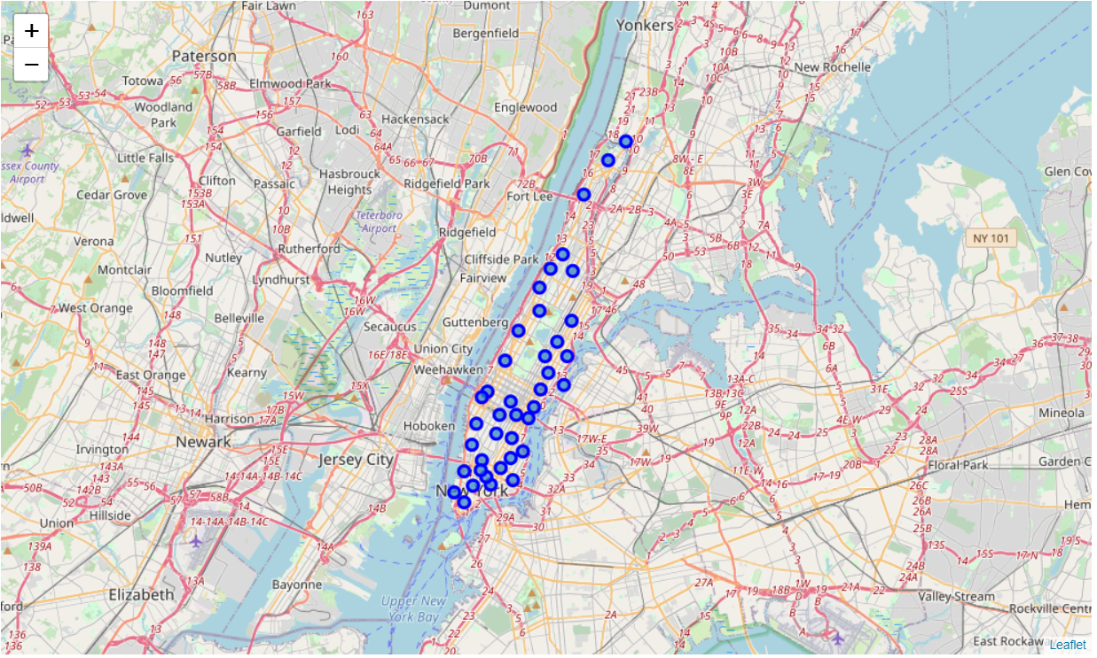
Our Focus Is Restricted To These Neighborhoods Within Manhattan.

Slide 6
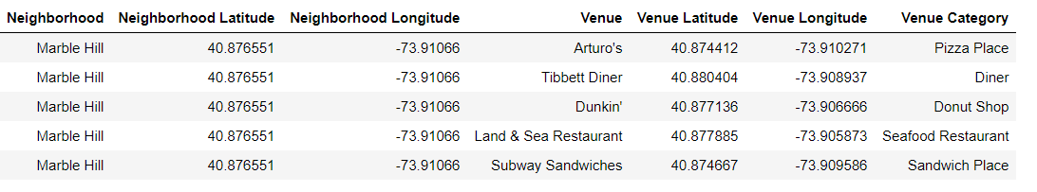
Using Foursquare API, We Can Pull In All Restaurants In Manhattan Within A Specified Range And Observe: There Are 2K+ Restaurants &122 Types Of Restaurants.
Sample Output From Foursquare

Slide 7
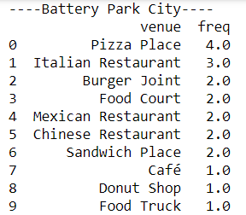
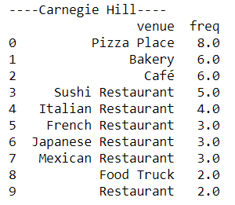
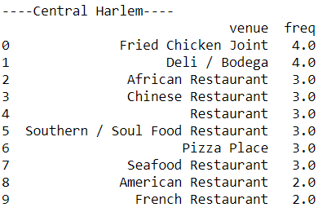
In Addition, We Can Assess Frequency By Top 10 Restaurants Within Each Neighborhood.

Slide 8
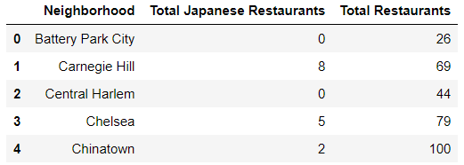
In The Dataset, We Can Determine Both The Number Of Japanese Restaurants And Total Restaurants.
Sample Data

Slide 9
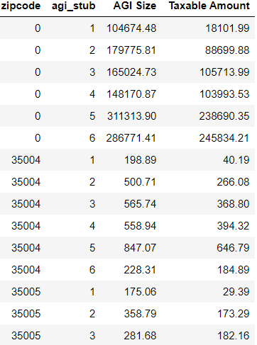
We Can Pull In Adjusted Gross Income (AGI) By Zip Code. We Are Restricting This Further To AGI_Stub 3+, Which Indicates AGI >=75K.
Sample Data

Slide 10
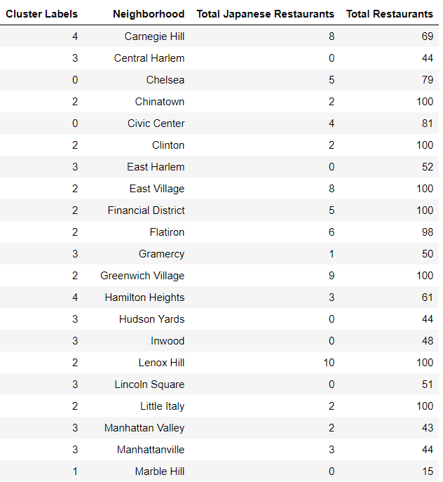
Cluster Resulting Dataset Using K Means To Review Similar Neighborhoods.

Slide 11
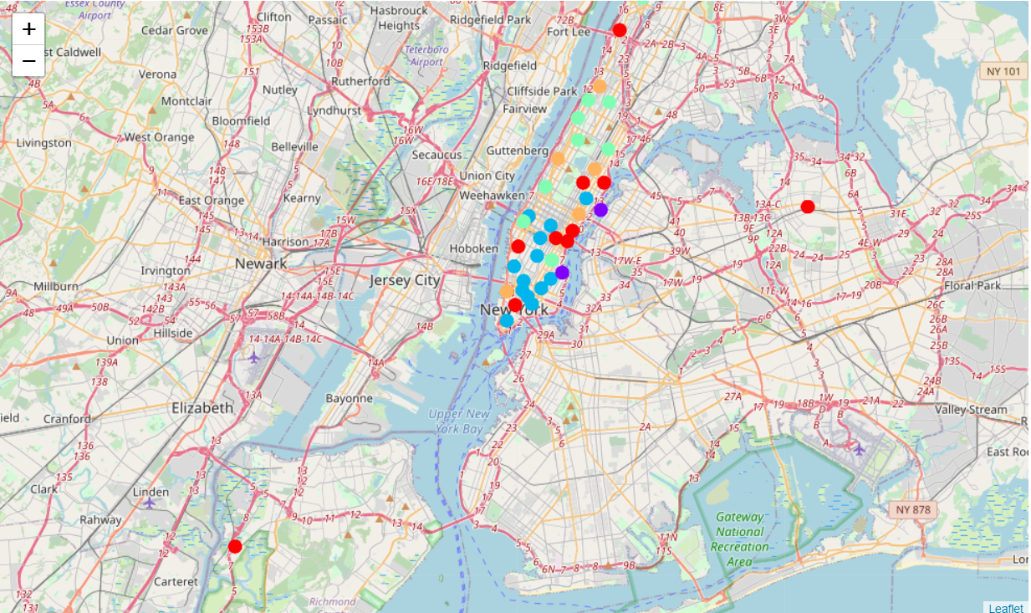
…And Mapping The Results.

Slide 12
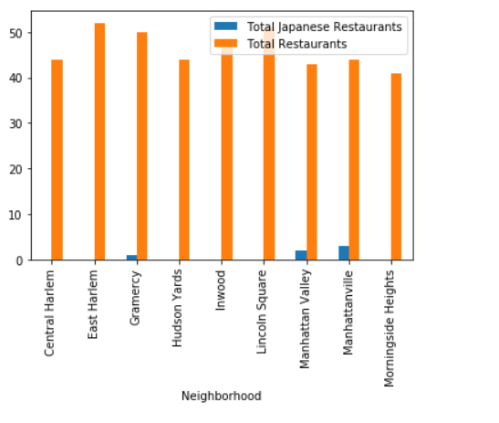
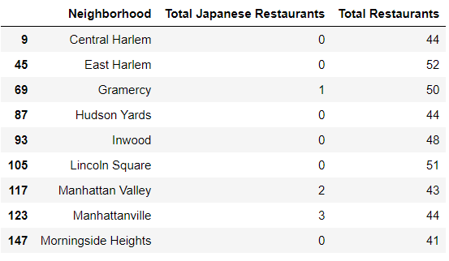
Results: One Cluster Has Little To None Japanese Restaurants Currently.

Slide 13
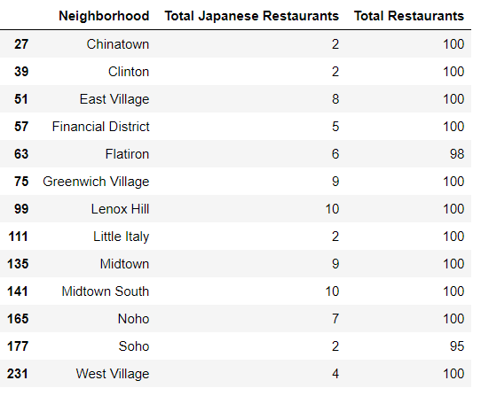
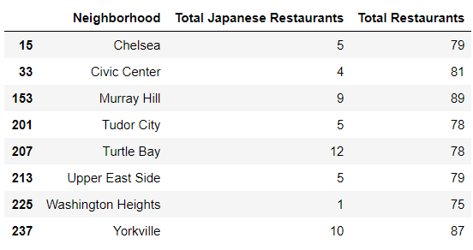
Results (Cont): Other Clusters Have Many Japanese Restaurants And More Restaurants In General Too.

Slide 14
Discussion: Washington Heights, Chinatown, Clinton, Little Italy, and Soho Are The Better Areas To Consider. These Areas Are Clustered Together And Currently Have High Restaurant Counts And Low Japanese Restaurant Counts.

Slide 15
Conclusion
Based On The Data We Used, There Is Opportunity To Open Up A Japanese Restaurant In Multiple Locations Within Manhattan
Although Our Data Shows Potential Areas To Open A Japanese Restaurant, Additional Analysis Should Be Done To Address The Following
NYC Dataset Is From 2014
IRS Dataset Is From 2017
Is Foursquare Accurate (ie Are There More Japanese Restaurants In This Location)
Marketing: Does This Area Want Japanese Restaurants
It Would Be Interesting To Add Additional Datapoints Such As Population Density, Race, etc

